Slide 1
CSCI1540 Fundamental Computing with C++
Introduction
Fall, 2019

Slide 2
Outline
Introduction to programming
Overview of C++

Slide 3
What is a Computer?
A computer is a machine that manipulates data according to a list of intructions
E.g., Desktop/Laptop PC, smartphone, tablet, Xbox, …
What do computers have in common?

Slide 4
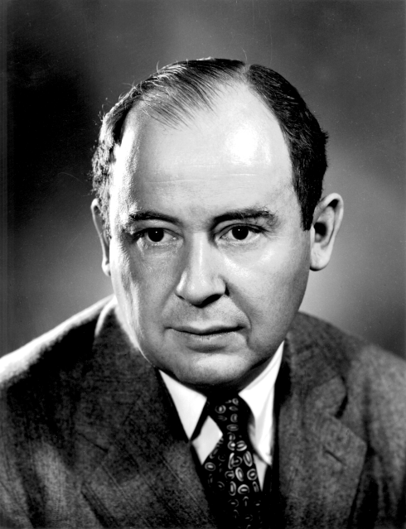
Computer Organization
Input Unit
CPU
John von Neumann
Arithmetic
& Logic Unit
Memory Unit
Storage Unit
Control
Unit
Output Unit
Flow of data
Von Neumann Architecture

Slide 5
Computer Organization
Input
Unit
CPU
Arithmetic
& Logic Unit
Memory
Unit
Storage
Unit
Control
Unit
Output
Unit
Input unit
Obtains information from input devices
Keyboard, mouse, microphone, touch panel, network, …
Output unit
Takes information processed by computer
Places information on output devices
Monitor, printer, speaker, haptic feedback, network, …

Slide 6
Computer Organization
Input
Unit
CPU
Arithmetic
& Logic Unit
Memory
Unit
Storage
Unit
Control
Unit
Output
Unit
Central processing unit (CPU)
Arithmetic and logic unit (ALU)
Performs arithmetic calculations and logic decisions
Control unit (CU)
Supervises and coordinates other sections of computer

Slide 7
Computer Organization
Input
Unit
CPU
Arithmetic
& Logic Unit
Memory
Unit
Storage
Unit
Control
Unit
Output
Unit
Memory unit
Rapid access, relatively low capacity “warehouse” section
Retains information from input unit
Immediately available for processing
Retains processed information
Until placed on output devices
Refers to the Random Access Memory (RAM)

Slide 8
Computer Organization
Input
Unit
CPU
Arithmetic
& Logic Unit
Memory
Unit
Storage
Unit
Control
Unit
Output
Unit
Secondary storage unit
Long-term, high-capacity “warehouse” section
Storage
Data and programs that are not immediately needed
Secondary storage devices
Hard drives, optical drives, USB drives, memory cards, …
Slower access (in time) than primary memory
Less expensive (per byte) than primary memory

Slide 9
What is Programming?
A programming language is an artificial language designed to express computer instructions
High-level programming languages → more English-like, easier to use
E.g., BASIC, Pascal, C, C++, Java, JavaScript, PHP, Python, …
To execute a program written in a high-level programming language, we need a compiler and/or an interpreter

Slide 10
What is Programming?
10111111
10101011
…
11010110
10101111
11110101
00101101
10101111
01110101
00111101
11011110
10101100
11100000
10101111
💻
😳
Compiler
or
Interpreter
A = 1 + 2;
print A;
Compiler: a program that translates instructions written in a programming language into another language (usually a machine language). The resulting program can then be executed by the computer directly
Interpreter: a program that directly executes instructions written in a programming language

Slide 11
Fundamentals of Programming
Understand the basic concepts and principles of programming
Understand (and sometimes memorize) the syntax of a programming language
Express your idea and solution into equivalent instructions
Know what APIs (Application Programming Interface) are available and learn how to use them

Slide 12
Overview of C++
History of C and C++
Why C++?
Why not C++?
Phases of C++ programs
First view of a C++ program

Slide 13
History of C and C++
History of C
Developed by Dennis Ritchie (at Bell Lab) around 1970
General purpose, mid-level language
Development language of UNIX and many other software
History of C++
Developed by Bjarne Stroustrup (at Bell Lab) around 1980
C with object-oriented programming (OOP) support
Include features to support OOP, which is a new paradigm for designing and constructing programs

Slide 14
Why C++?
General purpose
Highly platform independent
High performance
Ability to directly access/manipulate contents in memory
Writing device drivers or low-level system programs
Widely use
Support object-oriented programming

Slide 15
Why Not C++?
Inherits the drawbacks of C
A “bloated” programming language
Platform dependent 😵
“Mix and match” OOP and procedural programming

Slide 16
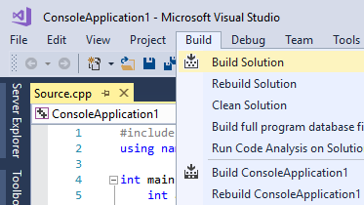
Phases of C++ Programs
Source
files
(.cpp files)
Compile
Object
files
(.obj files)
Link
Executable
program
(.exe files)
Compile: Translate C++ codes into equivalent machine (or binary) codes
Each object file is like a “part” of a program
Link: Put all the binary “parts” together to form an executable program
In VS/Xcode, Compile + Link = “Build”
Other object files and library files
(.obj, .lib, .dll, …)
You edit these files

Slide 17
First View of a C++ Program
1
2
3
4
5
6
7
8
9
10
11
12
// The first C++ program
#include <iostream>
using namespace std;
int main()
{
cout << "Hello! ";
cout << "Welcome to CSCI1540\n";
cout << “Fundamental Computing with C++!\n";
return 0;
} // End of function "main"
Hello! Welcome to CSCI1540
Fundamental Computing with C++!
A C++ program that outputs a few lines of text

Slide 18
1
2
3
4
5
6
7
8
9
10
11
12
// The first C++ program
#include <iostream>
using namespace std;
int main()
{
cout << "Hello! ";
cout << "Welcome to CSCI1540\n";
cout << "Fundamental Computing with C++!\n";
return 0;
} // End of function "main"
Single-line comments
Every program has some basic elements

Slide 19
1
2
3
4
5
6
7
8
9
10
11
12
// The first C++ program
#include <iostream>
using namespace std;
int main()
{
cout << "Hello! ";
cout << "Welcome to CSCI1540\n";
cout << "Fundamental Computing with C++!\n";
return 0;
} // End of function "main"
Single-line comments
Comments
Provide program documentation
Improve program readability
Ignored by compiler
Single-line comments begins with two slashes: //
Multi-line comments with the markers /* and */
/* This is a
multi-line comment */

Slide 20
1
2
3
4
5
6
7
8
9
10
11
12
// The first C++ program
#include <iostream>
using namespace std;
int main()
{
cout << "Hello! ";
cout << "Welcome to CSCI1540\n";
cout << "Fundamental Computing with C++!\n";
return 0;
} // End of function "main"
The main function
Every C++ program has exactly one function named “main”

Slide 21
1
2
3
4
5
6
7
8
9
10
11
12
// The first C++ program
#include <iostream>
using namespace std;
int main()
{
cout << "Hello! ";
cout << "Welcome to CSCI1540\n";
cout << "Fundamental Computing with C++!\n";
return 0;
} // End of function "main"
Beginning part of the main function
Body of the main function
Ending part of the main function
Characteristics of the main function
The function body contains the instructions that make up your program

Slide 22
1
2
3
4
5
6
7
8
9
10
11
12
// The first C++ program
#include <iostream>
using namespace std;
int main()
{
cout << "Hello! ";
cout << "Welcome to CSCI1540\n";
cout << "Fundamental Computing with C++!\n";
return 0;
} // End of function "main"
Statements
Each instruction is called a statement
A statement is terminated by a semicolon (;)
A single statement can possibly perform many tasks

Slide 23
1
2
3
4
5
6
7
8
9
10
11
12
// The first C++ program
#include <iostream>
using namespace std;
int main()
{
cout << "Hello! ";
cout << "Welcome to CSCI1540\n";
cout << "Fundamental Computing with C++!\n";
return 0;
} // End of function "main"
#include <iostream>
using namespace std;
We need these in order to use “cout” to perform output in the program
Performing simple output
cout is an object that knows how to send output to the screen
"Hello! " represents the data to be passed to cout
<< (called the insertion operator) indicates that you want to pass the data on the right of the operator to cout

Slide 24
1
2
3
4
5
6
7
8
9
10
11
12
// The first C++ program
#include <iostream>
using namespace std;
int main()
{
cout << "Hello! ";
cout << "Welcome to CSCI1540\n";
cout << "Fundamental Computing with C++!\n";
return 0;
} // End of function "main"
String literals
String: a sequence of characters
String literal: a string enclosed by a pair of double quote characters (")

Slide 25
1
2
3
4
5
6
7
8
9
10
11
12
// The first C++ program
#include <iostream>
using namespace std;
int main()
{
cout << "Hello! ";
cout << "Welcome to CSCI1540\n";
cout << "Fundamental Computing with C++!\n";
return 0;
} // End of function "main"
Do not confuse backslash character (\) with forward slash (/)
Hello! Welcome to CSCI1540
Fundamental Computing with C++!
Representing special characters in a string literal
\n newline (enter key)
\\ backslash (\)
\" double quote (")
\t tab key

Slide 26
1
2
3
4
5
6
7
8
9
10
11
12
13
#include <iostream>
using namespace std;
int main()
{
statement_1;
statement_2;
statement_3;
…
statement_n;
return 0;
} // End of function "main"
General form of a simple C++ program

Slide 27
Summary
Basic components of a computer
What it means by programming in a high level programming languages
Advantages of learning C++
Design a solution first, program later
First look at a C++ program
Next: C++ Basics

